Slide 1



Global SuperStore 2016 Project
View in Power BI
Last data refresh:
5/5/2023 11:23:32 AM UTC
Downloaded at:
5/5/2023 11:40:09 AM UTC

Slide 2
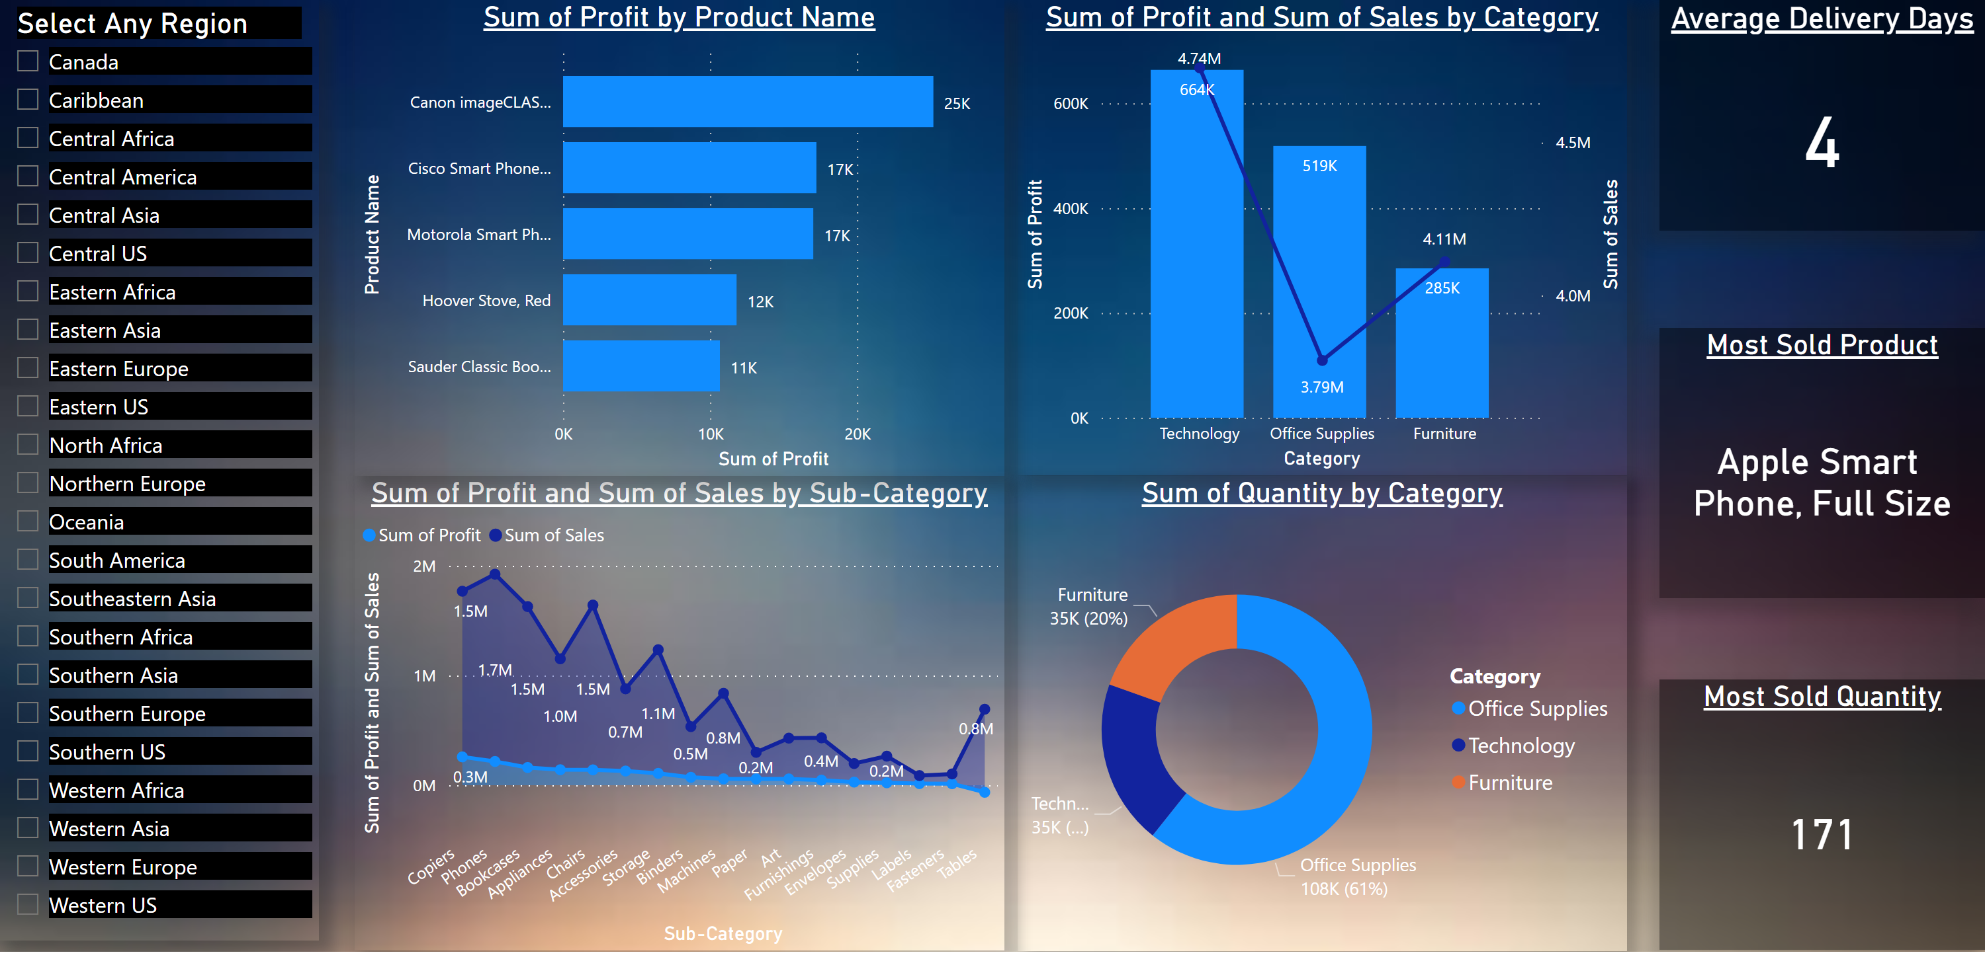
Overall Dashboard
Notes:
slicer
No alt text provided
stackedAreaChart
No alt text provided
lineStackedColumnComboChart
No alt text provided
Average Delivery Days
No alt text provided
Most Sold Quantity
No alt text provided
donutChart
No alt text provided
Most Sold Product
No alt text provided
clusteredBarChart
No alt text provided

Slide 3
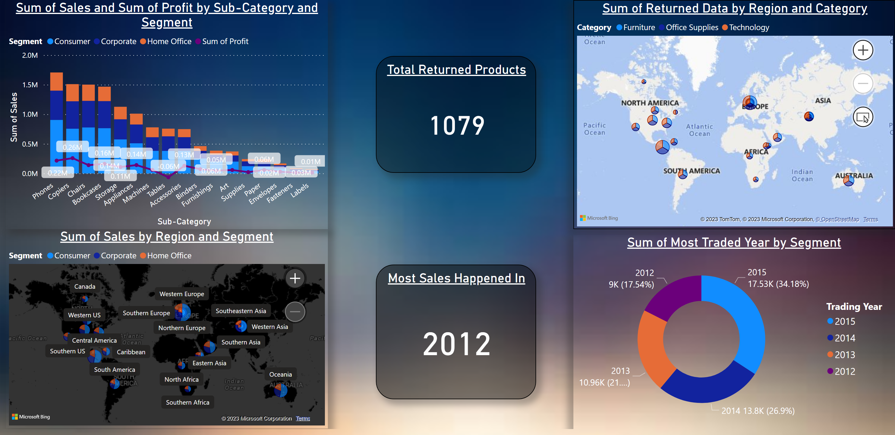
Consumer Overview
Notes:
lineStackedColumnComboChart
No alt text provided
Total Returned Products
No alt text provided
map
No alt text provided
Sum of Most Traded Year by Segment
No alt text provided
Most Sales Happened In
No alt text provided
map
No alt text provided

Slide 4
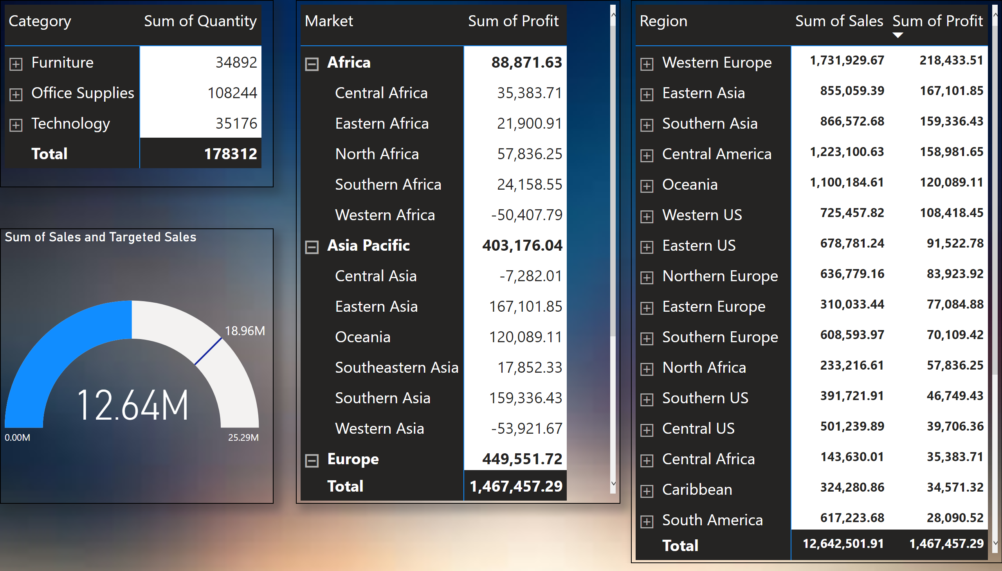
Tabular Overview
Notes:
pivotTable
No alt text provided
pivotTable
No alt text provided
pivotTable
No alt text provided
gauge
No alt text provided

Slide 5
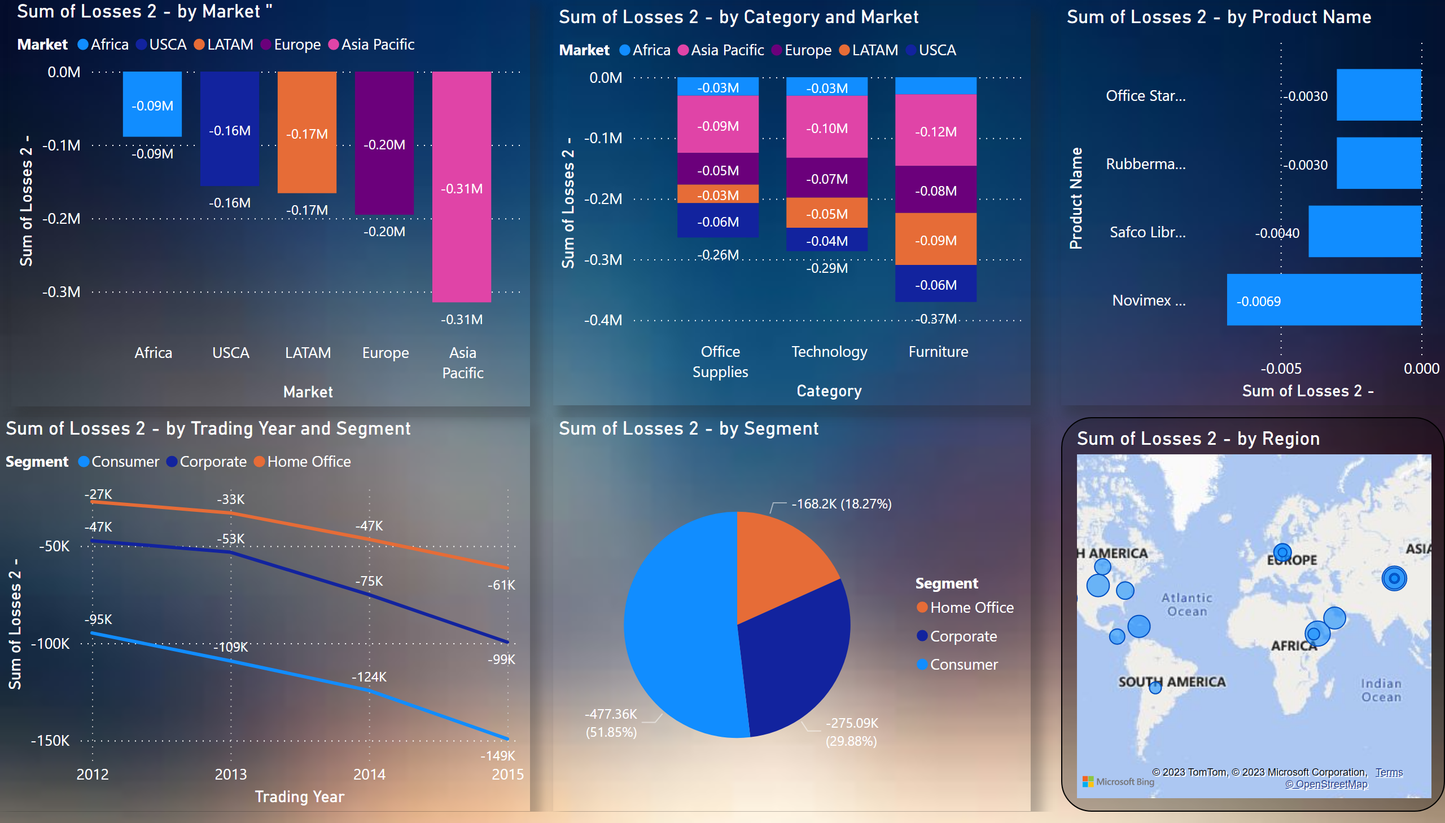
Losses Overview
Notes:
Sum of Losses 2 - by Market "
No alt text provided
columnChart
No alt text provided
lineChart
No alt text provided
pieChart
No alt text provided
barChart
No alt text provided
map
No alt text provided

